Slide 1
Software Construction and Development
Software Engineering Process Infrastructure
M Khizar Hayat
Email: Khizerhayat@ucp.edu.pk
Office: Building D, 2nd floor
OFFICE HOURS: Fri (9:00 to 11:00)

Slide 2
What Do We Mean by a Process?
Is a series of steps involving activities, constraints, and resources to produce an intended output
  Prepare for exams
  Conduct a software competition
  Organize a trip
  Write a term project report
Involves a set of tools and techniques
  Block diagrams
  Notations

Slide 3
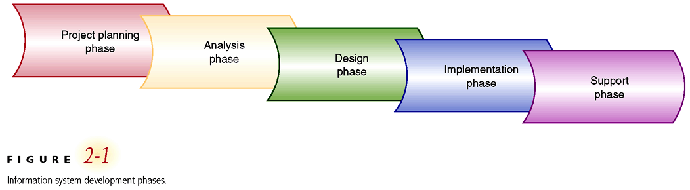
System Development Phases

Slide 4
Phases of the Systems Development Lifecycle (SDLC)
Project planning: initiate, ensure feasibility, plan schedule, obtain approval for project
Analysis: understand business needs and processing requirements
Design: define solution system based on requirements and analysis decisions
Implementation: construction, testing, user training, and installation of new system
Support: keep system running and improve

Slide 5
Planning Phase of SDLC
Define business problem and scope
Produce detailed project schedule
Confirm project feasibility
  Economic, organizational, technical, resource, and schedule
Staff the project (resource management)
Launch project → official announcement

Slide 6
Analysis Phase of SDLC
Gather information to learn problem domain
Define system requirements
Build prototypes for discovery of requirements
Prioritize requirements
Generate and evaluate alternatives
Review recommendations with management

Slide 7
Design Phase of SDLC
Design the application architecture
Design the user interfaces
Design the system interfaces
Design and integrate the database
Prototype for design details
Design and integrate system controls

Slide 8
Implementation Phase of SDLC
Construct software components
Verify and test
Convert data
Train users and document the system
Install the system

Slide 9
Support Phase of SDLC
Maintain system
  Small patches, repairs, and updates
Enhance system
  Small upgrades or enhancements to expand system capabilities
  Larger enhancements may require separate development project
Support users
  Help desk and/or support team

Slide 10
What is a Process Model?
Description of a process, evolved overtime, in a certain format:
  May use text, pictures, or a combination
  Contains key process features

Slide 11
What is a Software Process Model?
A Software Process Model is a structured framework that defines how software is developed step-by-step — from idea to deployment and maintenance.
It describes:
Activities (what to do)
Roles (who will do it)
Artifacts (what documents/products are produced)
Flow of work (in what order things happen)

Slide 12
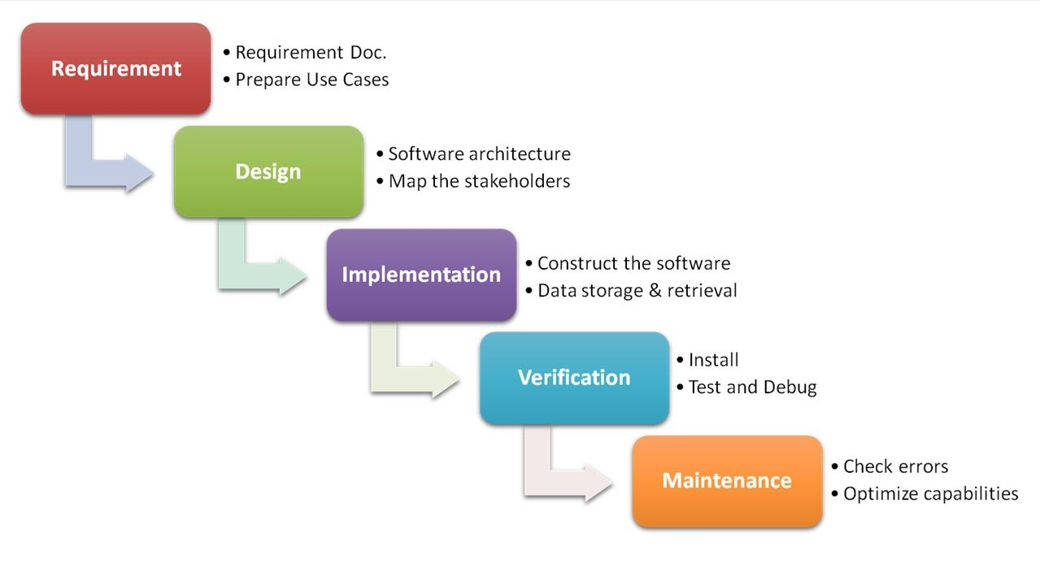
Waterfall Model (Contd.)

Slide 13
Waterfall Model
One of the first process development models proposed
  Uncontrolled Software Development Process
  No Iterations in WF
Works for well understood problems with minimal or no changes in the requirements
Simple and easy to explain to customers
It presents
  a very high-level view of the development process
  sequence of process activities
Each major phase is marked by milestones and deliverables (artefacts)

Slide 14
Advantages & Dis-Advantages of Waterfall Model
Advantages | Disadvantages
Simple and easy to understand | Difficult to accommodate requirement changes
Clear structure with defined phases | No working software until late in the process
Easy to manage due to fixed milestones | High risk if requirements are wrong
Well-documented at every stage | Testing starts only after development is complete
Suitable for small and well-defined projects | Not suitable for complex or long-term projects
Easy to measure progress | Customer feedback comes very late
When to Choose Waterfall?
  Requirements are stable
  Technology is well understood
  Project scope is small to medium
  Strict documentation is required
  Client does not expect frequent changes

Slide 15
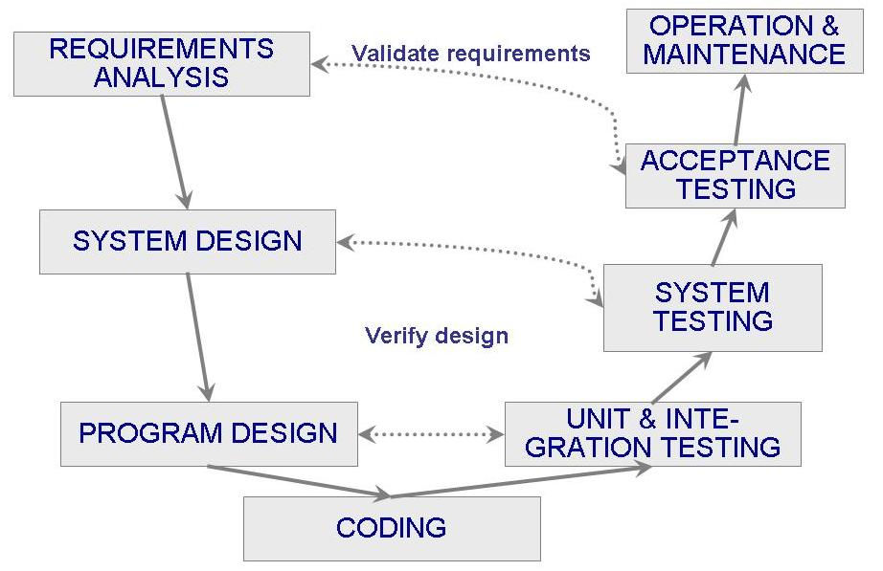
V-Model

Slide 16
V-Model
A variant of the waterfall model
Uses unit testing to verify procedural design
Uses integration testing to verify architectural (system) design
Uses acceptance testing to validate the requirements
If problems are found during verification and validation, the left side of the V can be re-executed before testing on the right side is re-enacted

Slide 17
Verification and Validation (V&V)
Verification means Are we building the product right?
  Verification is the process of checking that a software achieves its goal without any bugs.
  It is the process to ensure whether the product that is developed is right or not.
  It verifies whether the developed product fulfills the requirements that we have.
Validation means Are we building the right product?
  Validation is the process of checking whether the software product is up to the mark or in other words product has high level requirements.
  It is the process of checking the validation of product i.e. it checks what we are developing is the right product.
  it is validation of actual and expected product.

Slide 18
Use cases for the V-shaped model
Requirements are clear and stable
Project is safety-critical
High reliability is required
Strict testing and documentation needed
Regulatory compliance is mandatory

Slide 19
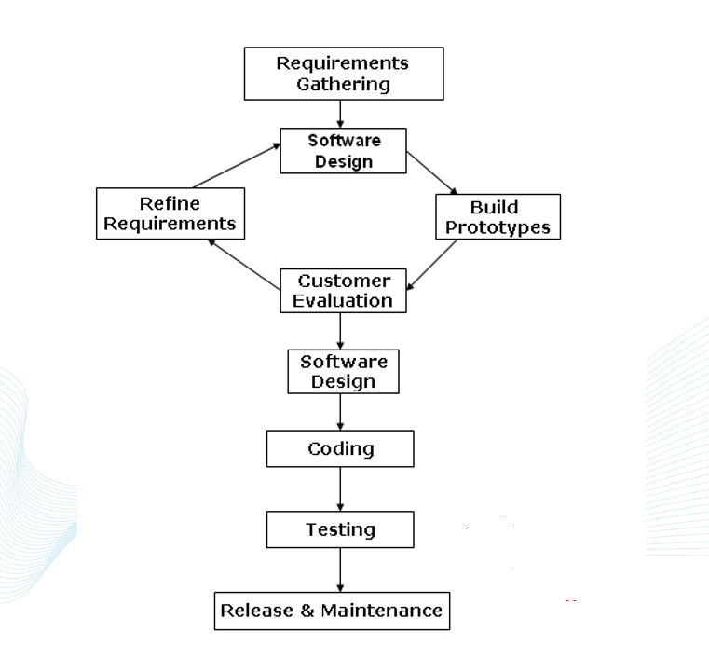
Prototyping Model

Slide 20
PROTOTYPING
A limited representation of a design that allows users to interact with it and to explore its suitability
Allows stakeholders to interact with the planned product, gain some experience of using and explore imagined uses
Production of an intermediary product to be used as a basis
for testing
Aim is to save on time and money
Aim is to have something that can be tested with real users

Slide 21








PROTOTYPING
You never get it right first time
If at first you don‟t succeed …
prototype
OK?
design
evaluate
done!
re-design

Slide 22
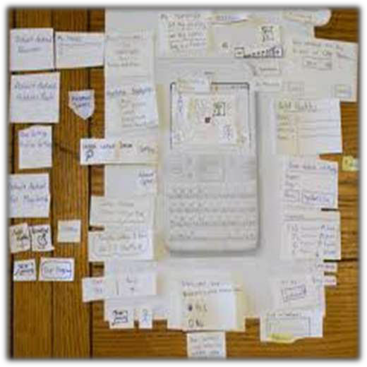
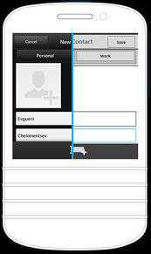

Slide 23
THROWAWAY and EVOLUTIONARY Prototypes
Throwaway prototypes
  are built, tested and thrown away (useful in early stages)
  knowledge gained contributes to final system / next prototype
  can be expensive
  The prototype is used to get the specs right, then discarded!!
Evolutionary prototypes
  are not discarded but serve as basis for next iteration of the design
  danger of initially bad designs persisting
  The prototype eventually becomes the product
31

Slide 24
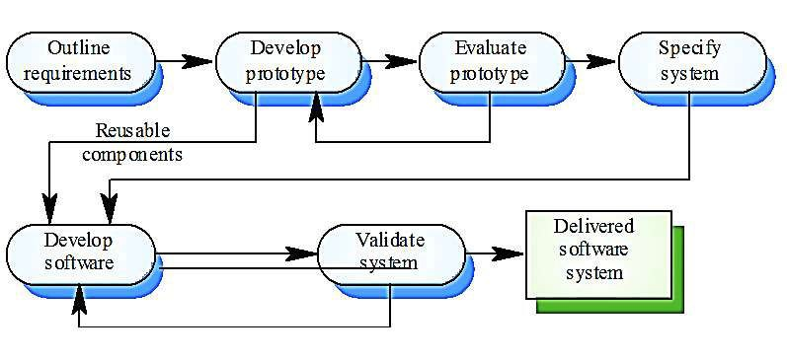
THROW-AWAY PROTOTYPING

Slide 25
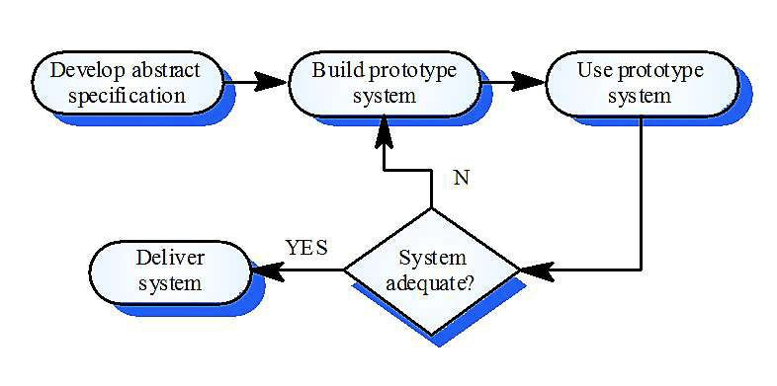
EVOLUTIONARY PROTOTYPING

Slide 26
Agile methods
Dissatisfaction with the overheads involved in software design methods of the 1980s and 1990s led to the creation of agile methods.
These methods:
  Focus on the code rather than the design
  Are based on an iterative approach to software development
  Are intended to deliver working software quickly and evolve this quickly to meet changing requirements.

Slide 27
Agile manifesto
We are finding better ways of developing software by doing it and helping others do it. Through this work we have come to value:
  Individuals and interactions over processes
  Working software over comprehensive documentation
  Customer collaboration over contract negotiation
  Responding to change over following a plan

Slide 28
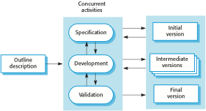
Incremental development

Slide 29
The principles of agile methods
Principle | Description
Customer involvement | Customers should be closely involved throughout the development process. Their role is to provide and prioritize new system requirements and to evaluate the iterations of the system.
Incremental delivery | The software is developed in increments with the customer specifying the requirements to be included in each increment.
People not process | The skills of the development team should be recognized and exploited. Team members should be left to develop their own ways of working without prescriptive processes.
Embrace change | Expect the system requirements to change and so design the system to accommodate these changes.
Maintain simplicity | Focus on simplicity in both the software being developed and in the development process. Wherever possible, actively work to eliminate complexity from the system.

Slide 30
Problems with agile methods
It can be difficult to keep the interest of customers who are involved in the process.
Team members may be unsuited to the intense involvement that characterizes agile methods.
Prioritizing changes can be difficult where there are multiple stakeholders.
Maintaining simplicity requires extra work.
It is difficult for organizations to move to a working model in which processes are informal and defined by development teams.

Slide 31
Agile methods and software maintenance
Most organizations spend more on maintaining existing software than they do on new software development. So, if agile methods are to be successful, they have to support maintenance as well as original development.
Two key issues:
  Are systems that are developed using an agile approach maintainable, given the emphasis in the development process of minimizing formal documentation?
  Can agile methods be used effectively for evolving a system in response to customer change requests?

Slide 32
Agile project management
The principal responsibility of software project managers
  to manage the project so that the software is delivered on time and within the planned budget for the project.
The standard approach to project management is plan-driven.
  Managers draw up a plan for the project showing what should be delivered, when it should be delivered and who will work on the development of the project deliverables.
Agile project management requires a different approach, which is adapted to incremental development and the particular strengths of agile methods.

Slide 33
Scrum
The Scrum approach is a general agile method that focus is on managing iterative development.
There are three phases in Scrum.
  The initial phase is an outline planning phase where you establish the general objectives for the project and design the software architecture.
  This is followed by a series of sprint cycles, where each cycle develops an increment of the system.
  The project closure phase wraps up the project, completes required documentation such as user manuals and assesses the lessons learned from the project.

Slide 34
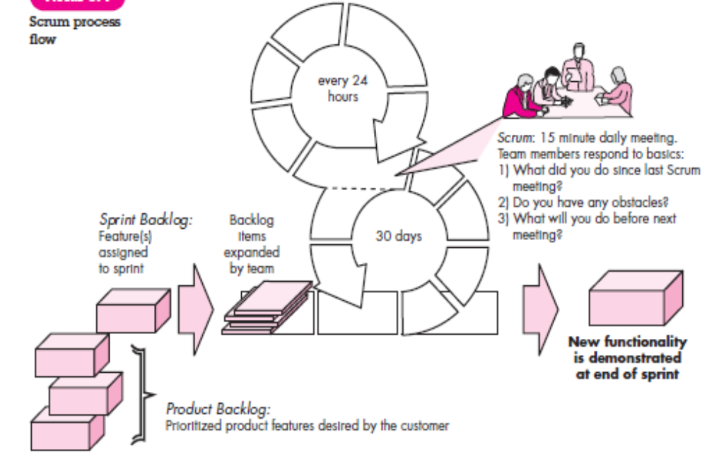
This means that everyone on the team knows what is going on and, if problems arise, can re-plan short-term work to cope with them
Sprints—consist of work units that are required to achieve a requirement defined
in the backlog
list of work to be done on the project.

Slide 35
Scrum roles
Product owner
  ensures that the team delivers value to the business. The Product Owner writes customer-centric items (typically user stories), ranks and prioritizes them, and adds them to the product backlog.
Scrum master
  protects the development team from external distractions.
  a facilitator who arranges daily meetings, tracks the backlog of work to be done, records decisions, measures progress against the backlog and communicates with customers and management outside of the team.
Development team
  Consists of 3 to 9 software engineers from cross functional area
  Include architects, programmers, analysts, QA experts, testers, and UI designers.

Slide 36
Kanban
https://www.youtube.com/watch?v=LnwStpJycXk

Slide 37
Scrum Ke Core Elements
1. Roles
Product Owner: Product vision define karta hai, backlog maintain karta hai, aur ensure karta hai ki team right priorities par kaam kare.
Scrum Master: Team ko Scrum practices follow karne mein guide karta hai, obstacles remove karta hai.
Development Team: Cross-functional members jo actual product build karte hain.
2. Artifacts
Product Backlog: Features, tasks aur requirements ki prioritized list.
Sprint Backlog: Current sprint ke liye selected items.
Increment: Har sprint ke end par deliver hone wala working product.
3. Events (Ceremonies)
Sprint Planning: Decide karna ki sprint mein kya deliver hoga.
Daily Scrum (Stand-up): 15-minute meeting jisme team progress discuss karti hai.
Sprint Review: Sprint ke end par stakeholders ko increment dikhaya jata hai.
Sprint Retrospective: Team apne process ko improve karne ke liye feedback discuss karti hai.

